Slide 1

Bay 3.5, Stage 4 8 Aces (For That Instagram Run) Course Designer: Marcel Englmaier
8 aces is an 9 round, 45 point Virginia Count Standards Exercise. There are 5 USPSA targets. The best one hit on T1 and the best two hits on T2-T5 will score. The start signal is audible.
The Handgun start position is standing in shooting box with wrists below belt. Handgun is loaded and holstered. Loading devices may be staged on the table. The PCC start position is standing in shooting box with with stock on belt. PCC is loaded with safety on and muzzle pointed downrange. Loading devices may be staged on the table.
String 1: On the audible start signal, from within the shooting box, engage T1 with 1 round only. String 2: On the audible start signal, from within the shooting box, engage T2 with 2 rounds only. Perform a mandatory reload and engage T3 with 2 rounds only. Perform a mandatory reload and engage T4 with 2 rounds only. Perform a mandatory reload and engage T5 with 2 rounds only.
Notes:
‹#›

Slide 2
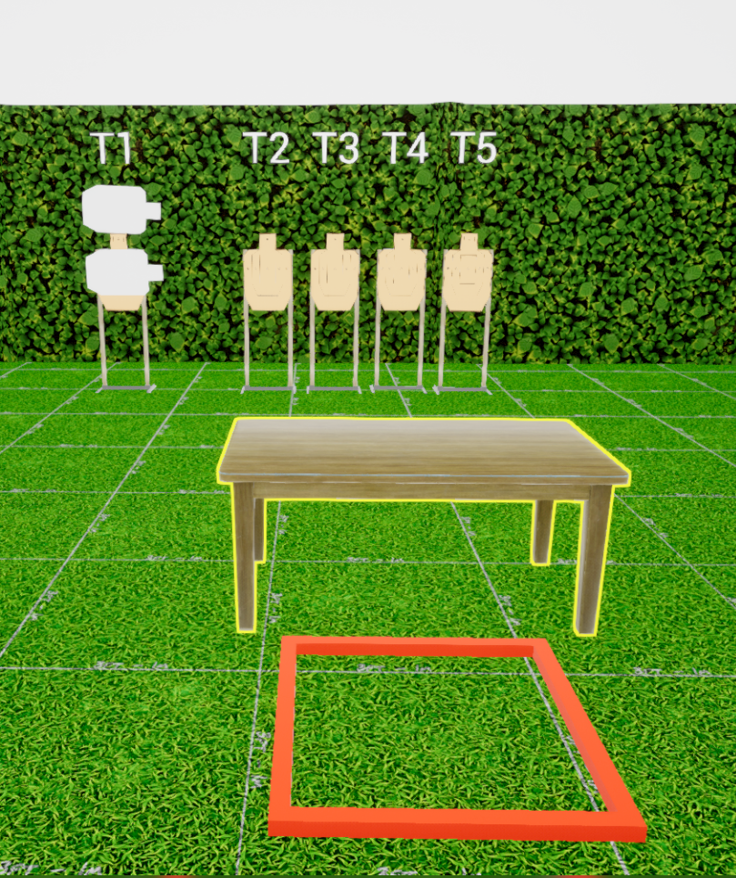
 | Stage 4 8 Aces (For That Instagram Run) Course Designer: Marcel Englmaier

